Slide 1


Medical Cost After Insurance
By: Jaime, Bandon, Matthew and Jasmin

Slide 2
The dataset
This data comes from Kaggle’s Medical Cost Personal Datasets
It represents the healthcare cost billed by insurance for individuals
Dataset shows the individual’s age, sex, BMI, number of children, smoking preference and region of residency

Slide 3
Questions
How does sex and age affect medical cost billed by insurance?
How does BMI affect medical billed by insurance?
How does region of residency and being a (non)smoker affect medical bill?
How does having children (0)(1-2)(3-5) affect insurance bill?

Slide 4
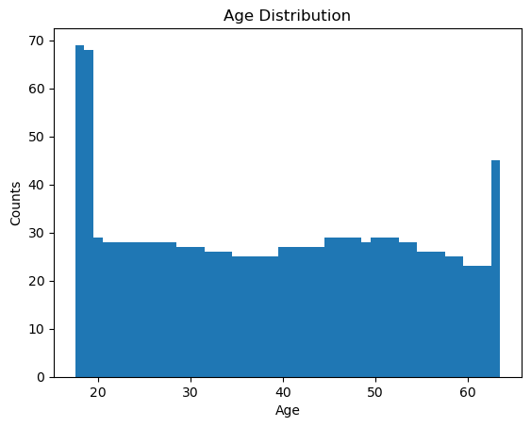
How does sex and age affect medical cost?

Slide 5
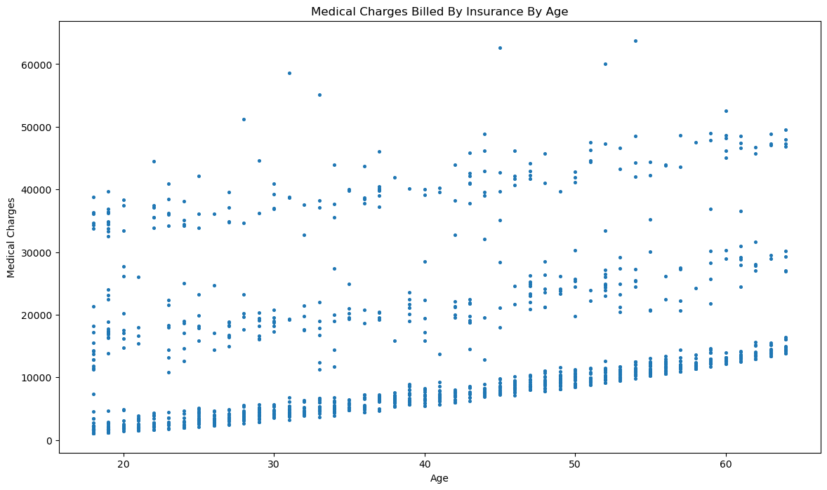
How does sex and age affect medical cost?

Slide 6
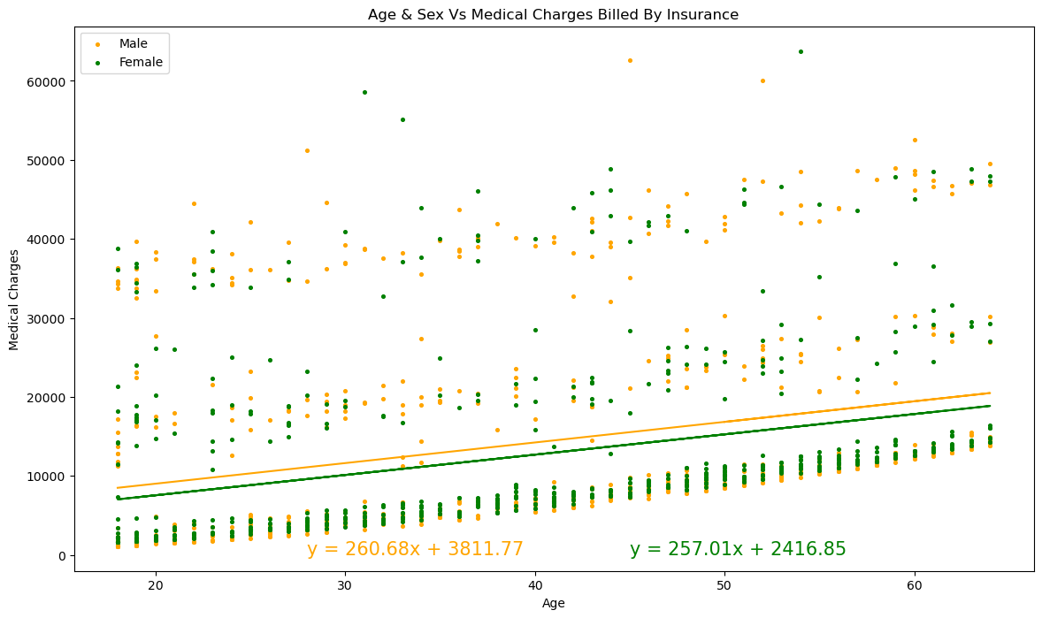
How does sex and age affect medical cost?

Slide 7
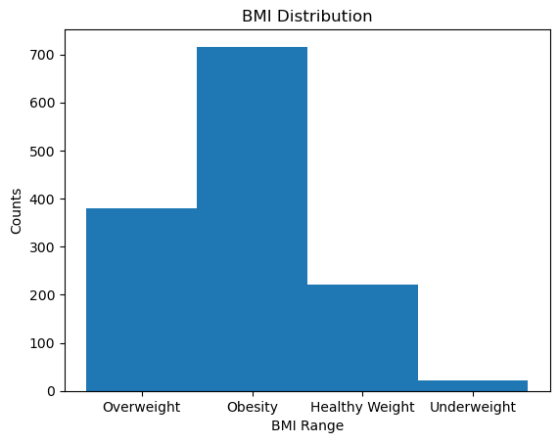
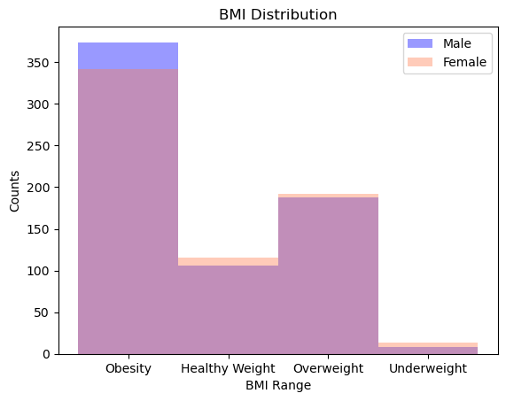
How does BMI affect medical cost?

Slide 8
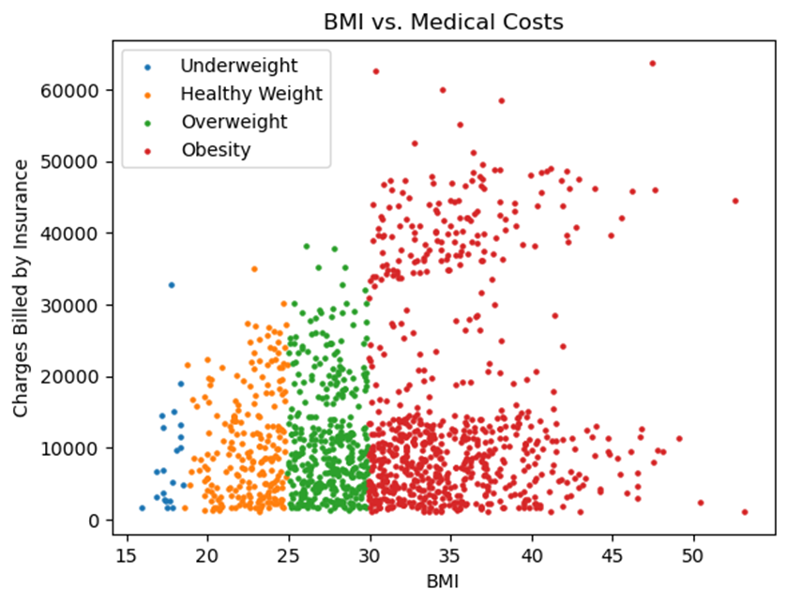
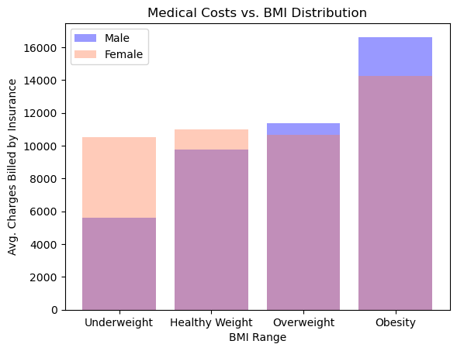
How does BMI affect medical cost?

Slide 9
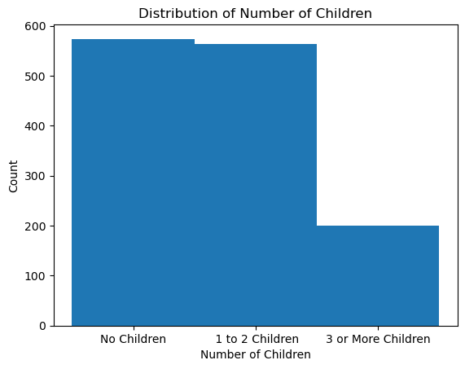
How does number of children affect medical cost?
In this histogram of the distribution of the number of children, we can see that three quarters of those survived have 0 to 2 children.

Slide 10
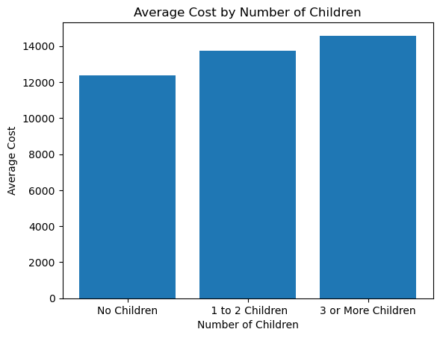
How does number of children affect medical cost?
In this bar chart we see that people who have no children pay an average of $12,365, 1-2 children $13,727 and 3 or more children pay an average of $14,576 after insurance.

Slide 11
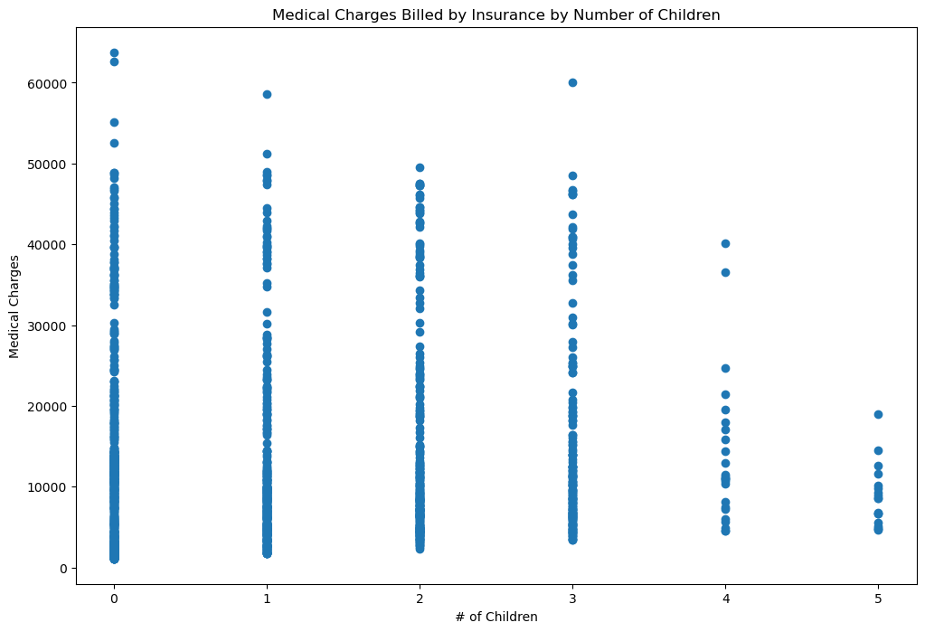
Here we have a scatterplot that shows that people with no children tend to have higher medical charges.
We can see there are a few outliers in this information that could affect the average charges that were calculated.

Slide 12
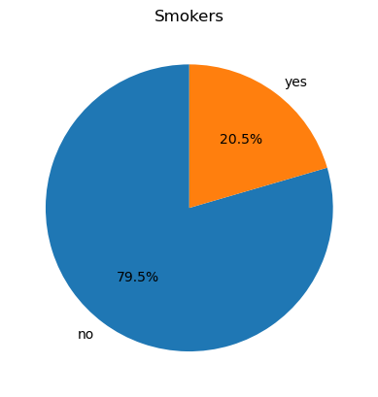
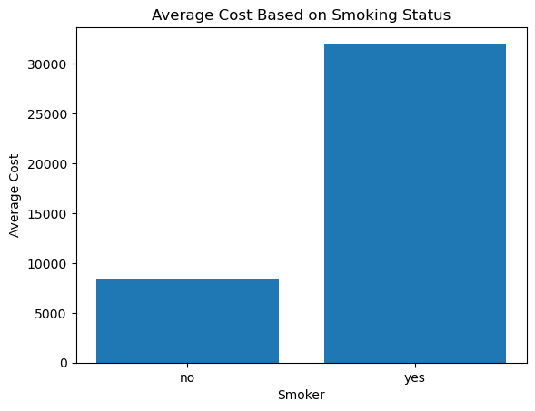
How does region and be a (non)smoker affect medical cost?

Slide 13
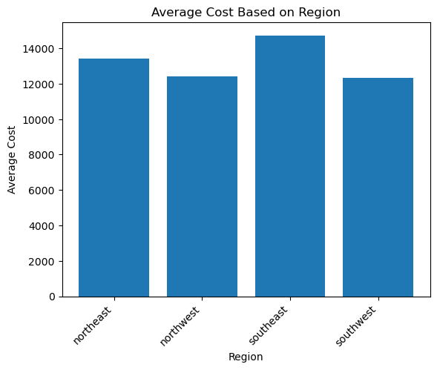
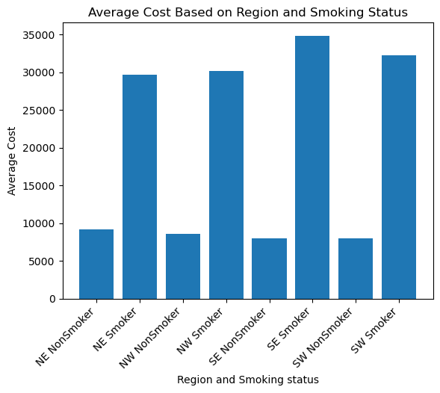
How does region and be a (non)smoker affect medical cost?

